Slide 1
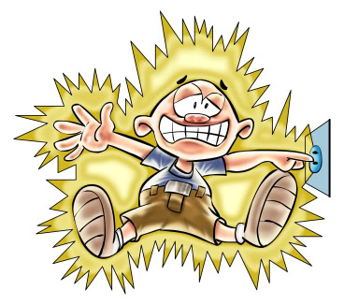
PART 2: CURRENT ELECTRICITY
CIRCUITS, APPLIANCES, POSSIBLE PROBLEMS
SERIES and PARALLEL

Slide 2
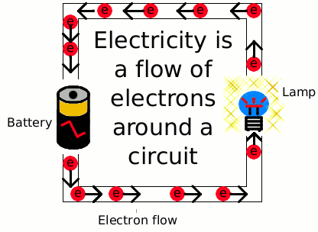
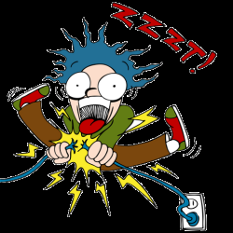
CURRENT ELECTRICITY
When electrons move from one atom to another in a conductor, the resulting flow of electrons is called current electricity. (Named like a river current.)
One side of the wire is negatively charged, because it has too many electrons.
The other side of the wire is positively charged, because it has a shortage of electrons.
So (in Grade 8) the electrons move from negative, through the wire, to positive – Nature tries to balance it out.
The pathway followed by the electrons is called its circuit.

Slide 3
WHAT CAN BE IN A CIRCUIT
COMPONENT | SYMBOL | FUNCTION
Conductor |  | Current moves through it.
Open switch |  | Stops current.
Closed switch |  | Allows current to move.
Cell |  | Gives electrical energy.
Battery |  | 2 or more cells joined.
Light bulb |  | Converts electricity to light.
Resistor |  | Electrons struggle to move.
Fuse |  | Burns: stop high electricity.

Slide 4
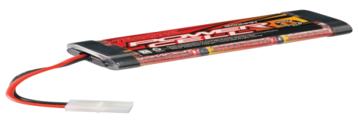
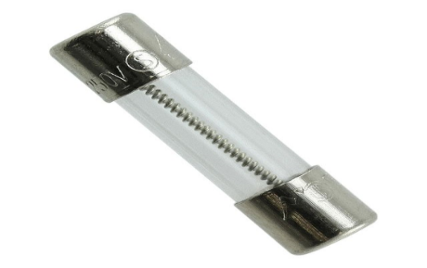
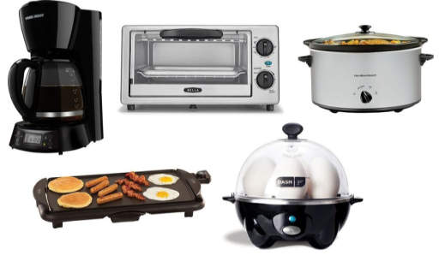
EXPLAINING the CIRCUIT PARTS
Conductor – allows electrons to move.
Cell – power source with positive and negative terminals.
Battery – two or more cells joined together.
Switch – used to break the circuit so that all electrons stop moving.
Fuse – a weak conductor that melts if the circuit becomes overheated from a short-circuit. (It does the same job of circuit-breaker as do trip-switches.)
Appliance – converts electrical energy to other forms of energy for us to use.

